Slide 1

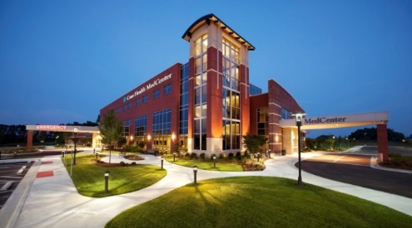
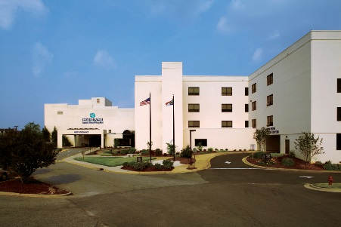
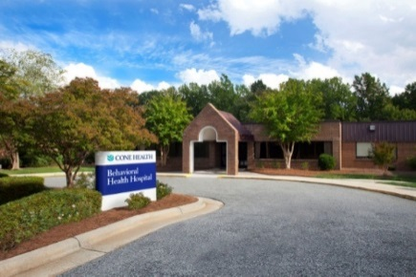

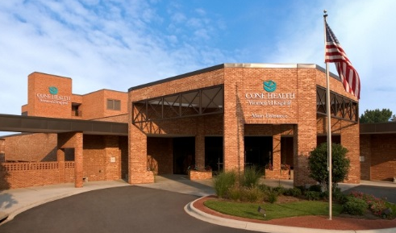

Welcome to
Cone Health
Notes:
2017
Top left to right: WL / MCHP / AP
Middle: BHH / ARMC / WH
Bottom: MC
10,000+ employees
Largest private employer in Guilford County
6 hospitals (1200+ beds)
100+ Physician Practices
Four Urgent Care Centers

Slide 2

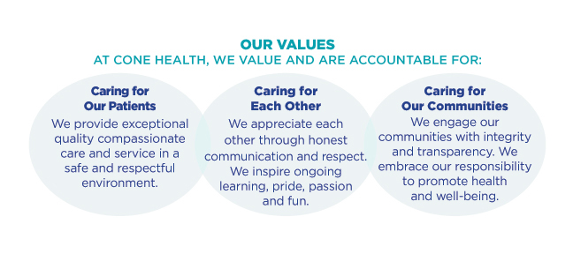
Our Values
Notes:
Now you are a part of the Exceptional people who make up the Cone Family. Everyone must be committed to the Cone Health Values and our Operating Principles and Practices.
4 Principles
I use evidence based practices to provide safe and exceptional patient care.
I communicate honestly and directly with care and respect.
I include people with diverse backgrounds, experiences, and points of view.
I see it, own it, solve it, do it, and celebrate it!
6 Practices
I keep patients safe by practicing the 4 R’s (right patient, right place, right time, right service).
I practice AIDET (acknowledge, introduce, duration, explain, thank you) for every patient interaction.
I assume the best intention and seek to understand.
I do not gossip; I take issues to the person who can do something about it.
I do what I say, when I say, and communicate. If I can’t I clean it up.
I thank someone every day.

Slide 3


Communication
Accountability
Respect
Empowerment
Notes:
iCare is the way we show our value of caring

Slide 4

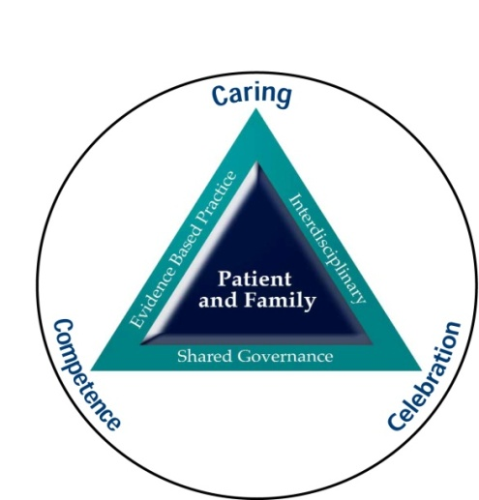

Nursing at Cone Health
Nursing
Philosophy
Notes:
All of the decisions that are made within an organization are governed by the philosophy. Cone uses several models to define our philosophy.
3 C’s of our Professional Practice Model – Caring, Competence, Celebration
2. Magnet Model - We practice relationship-based care with our patients and families at the center of everything we do, every decision we make.
We incorporate the 5 components of Magnet in our delivery of patient care:
Structural empowerment – facilities / equipment / supplies and people needed
Exemplary Professional practice – support continuing education – certification / RN - BSN
New Knowledge Innovations and Improvements – new practices to decrease falls, decrease infections
Transformational Leadership – looking into the healthcare needs of the future and aligning us to get ready for it
Empirical Outcomes – research supported practices lead to our Patient care outcomes – measure everything – patient satisfaction, nosocomial infections are now called HAIs- Hospital Acquired Infections - , CAUTIs, CLABSIs, Falls, pneumonia, Post Surgical Infections
3. Relationship –Based Care (RBC)
We didn’t just make this stuff up. You can google all of these models

Slide 5
Patient Care Partnership
A
Acknowledge
I
Introduce
D
Duration
E
Explanation
T
Thank You
Notes:
Acknowledge the patient and visitors. Say “hello.”
Introduce yourself and state your business. Why you are there and what you hope to accomplish.
Duration- If there is a delay in treatment tell the pt. how long the wait will be.
Explanation Tell the pt. why you are doing the treatment and/or giving the medication etc.
Thank You-
Thank the pt. for allowing you to care for him/her

Slide 6
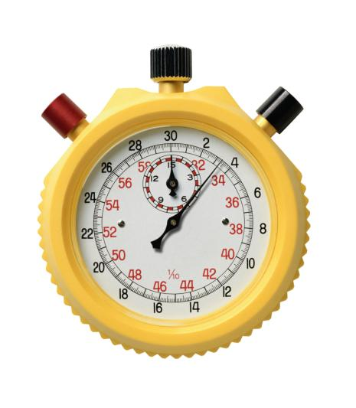

The Patient Care Partnership
Hourly Rounding with a Purpose
8 Behaviors important to Hourly Rounding with Purpose:
Use warm acknowledgement to reduce anxiety
Perform scheduled tasks
Address the 3 Ps (Pain, Potty, Positioning)
Assess additional comfort needs
Conduct an environmental assessment of the room
Prior to leaving the room, ask, “Is there anything else I can do for you?”
Tell each patient when you will be back
Document the round
Notes:
In addition to our internal models of patient care to guide our practice, we have several accrediting bodies we are accountable to – TJC (The Joint Commission), CMS (Centers for Medicare and Medicaid) American Hospital Association …
TJC gives is 2015 NPSGs:
1.ID patients correctly – Red Rule
2. Improve Staff Communication – Hand-off/ Hall pass
3. Use medicines safely – 5 rights / pharmacy unit-dose dispensing / medication bar-code scanner
4. Prevent Infection – Admission screening / isolation / post-op measures
5. ID patient safety risks – yellow arm band
6. Prevent mistakes in surgery – Red Rules
7. Use alarms safely
AHA Patient Care Partnership replaced Patient’s Bill of Rights - 2001
At Cone Hourly Rounding with a Purpose addresses these components
Informed
Choice
Access
Decisions
Respect
Confidentiality
Complaint Appeal
Responsibilities
Posted at admission desks and in patient admission folder provided to each patient on admission.

Slide 7



Important Initiatives
Handwashing
Fall Prevention
#1 way to prevent HIAs
Every time you cross the threshold!
FROG – friction rubs out germs
Ribbit
Yellow armband & Yellow socks
Other things that can be done?
Notes:
HIAs – Hospital Acquired Infections – CAUTIs / CLABSIs / Post Op / VAP – Ventilator Assisted Pneumonia

Slide 8


HIPAA and Corporate Compliance
Special Note
Privacy Flag in CHL
= Strict Privacy
Refrain from sharing experiences on social media
Save Trees & Confidentiality –
No printing practice
Notes:
When someone asks for that person by name, state, ”There is no record of that person being in the facility.”
If compromise, Safety Zone Portal (SZP). portal
BHH will have special practices regarding their patients that you will be oriented to when you go there.

Slide 9

Electronic Resources
Policies and Procedures
Clinical Key & Clinical Skills
Notes:
Information about a variety of diagnoses
Nursing Journals and Books that you can actually read on line.
Patient Education Materials
Medication Resources and drug calculators

Slide 10

Policies and Procedures
Cone Healthlink
Assist Desk at (2) 7242
Self-Serve Password reset instructions / The last 4 SSN = last 4 Student ID
Protect computer IDs or passwords
Viewed for your patient only
Cone Health Employees will need a 2nd ID for student / faculty role use
Notes:
Contact the Assist Desk at (2) 7242 for any trouble accessing CHL after you receive a log-in.

Slide 11

Policies and Procedures
SAFETY ZONE PORTAL
Events inconsistent with Cone Health Policies & Procedures, or not part of routine care
Leads to appropriate follow up
Event to be documented in patient chart
Do not document SZP record
in patient’s chart
Notes:
Risk Management
Any incident, which may have adverse consequences for patients, visitors, faculty/student should be reported immediately to Leadership on the department and a safety Zone Portal entry completed.
Report any incident immediately to your instructor / nurse
Serious & Non-Serious
Sentinel Events – death or permanent loss of function - immediately contact DD & RM. RCA – Root Cause Analysis / lit review / action plan
Goal: risk identification, risk evaluation, claims management
Minimize loss & improve quality of medical services and safety.
Appropriate Follow up by Department Director and Risk Management Department
Event to be factually documented in patient chart

Slide 12

Policies and Procedures

Slide 13

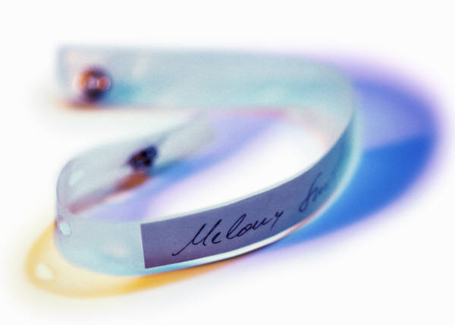
Policies and Procedures
Cone Health Red Rule #1
A time out before all invasive procedures.
Cone Health Red Rule #2
Patients are identified by both:
Name & Medical Record #
Before receiving medication, blood products or any procedure
Notes:
RED Rules are requirements that must be followed each and every time the occasion or situation arises
Because they are such a priority, they are considered RED to signify their importance.
RED Rules are rules that CANNOT be broken.
They are few in number and easy to remember.
They are associated with processes that can cause serious harm to patients.
# 3 - STUDENTS – No meds without instructor or RN

Slide 14



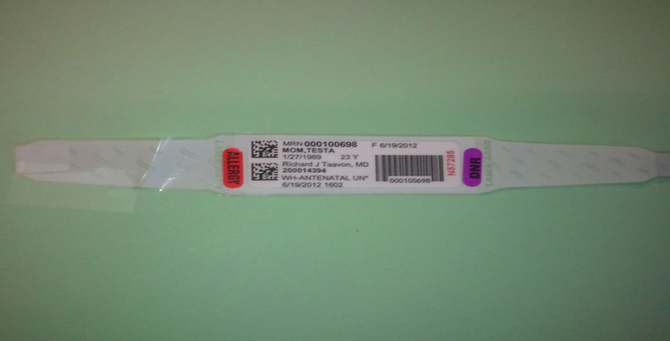



Banding Together for Patient Safety
Red stickers = Allergy
Purple stickers = DNR (Do Not Resuscitate)
Notes:
Green Latex allergy

Slide 15

Policies and Procedures
Ethical Issues / Interpreters
The patient’s primary nurse and your instructor can contact Pastoral Care to request an Ethics Consult or an Interpreter if needed
The American Nurses Association (ANA) Code of Ethics for Nurses provides guidelines for practice.
Notes:
Cone Health offers Ethics Consultation for patients, families, medical staff and ancillary staff involved in patient care.

Slide 16
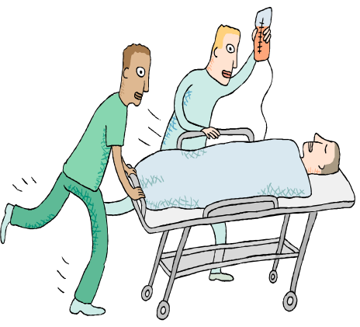
Policies and Procedures
Rapid Response Team (RRT)
Provides early and rapid intervention for patients outside the ICU setting whose condition is deteriorating.
CONDITION HELP
A Safety Net Program for Patients and Families
Ability for patients and families to activate a a call for help from any hospital phone
Notes:
Critical Care team responds to a call for critical care expertise to the patient’s bedside to assist with stabilizing and transferring to a higher level of care as needed
Purpose is to provide early and rapid interventions for more positive outcomes
Identify Early Warning Signs
Refer to Facility’s process for managing unstable patient situations

Slide 17
EMERGENCY CODES - Plain Language
Event | Sample Scripting
Evacuation | Overhead: Your attention please, Facility Alert, Immediate Evacuation, Unit 5Central.
Fire / Smoke Alarm | Overhead: Your attention please, Facility Alert, Fire Alarm activation Unit 5North.
Hazardous / Materials Spill | Overhead: Your attention please, Facility Alert, Chemical Spill, 1st Floor Laboratory.
Mass Casualty | Overhead: Your Attention Please, Facility Alert, External Mass Casualty Incident, Emergency Department.
Utility / Technology Interruption | Overhead: Your Attention please, Facility Alert IT Network Downtime, Implement downtime procedures
Weather | Overhead: Attention, Facility Alert Tornado Warning. Move away from windows to interior portions of the building.
Missing Infant / Child | Overhead Page: Security Alert Missing Infant, male infant, last seen in room 322.
Notes:
Previous emergency codes – Code red for fire, green for disaster, gray for restricted, pink for abduction.
Designed to avoid causing panic in patients and families.
Very attuned now; not fooling anyone.
Change is congruent with our goal of transparency
Also in accordance with the American Hospital association - Goal of standardization – minimizes confusion and errors
Code Blue – medical emergencies are typically going to be sent by pager not overhear; if overhead scrip would be “medical emergency and the
location”.
Bomb Threat / Suspicious Package – radio to security officers

Slide 18
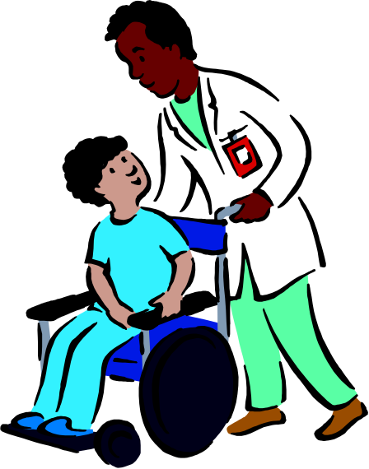
Safe Patient Handling
POLICY: All patient transfer/ lifting will be done safely and appropriately to protect the employee and patient from injury.
Consult with the patient’s nurse
and your clinical instructor for guidance.
Notes:
Tubes & slides reduce friction and provide a
safer, more comfortable move for patients

Slide 19
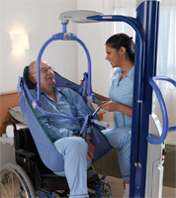
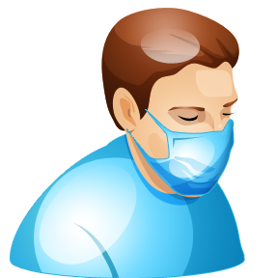
Safe Patient Handling
Maxi Move- Lifting and transfer device for the totally dependent individual
  Safe to transport throughout the facility
  Weigh individual during lifting
Isolation – Signage on doors with instructions. Do not enter patient’s rooms that require a special mask
Consult with the patient’s nurse and your clinical instructor for guidance.
Notes:
Equipment and signage to keep the patient and YOU safe from harm.
Able to lift from floor, bed, chair, toilet/bathing area and other areas
Sized from x-small to x-large and various specialty slings (e.g. amputee slings)
ARMC – same color now
Students are not Fit Tested and should not be assigned to patients requiring that type of PPE

Slide 20

Team Communication Method
General Guidelines
SBAR – Effective communication tool. Consistent and organized to promote patient safety
Gather information prior to communication
Situation
Background
Assessment
Recommendations
Notes:
Used for reports, hand-offs and phoning a provider
Situation – ID self, patient & location. Briefly describe situation and severity.
Background – Adm date & dx, recent surgery or procedures & dates,
Assessment – RN assessment
Recommendations – based on your assessment, pathways and situation
Phoning a provider or rapid response … gather information prior to communication: MR, current meds, IVs, allergies, recent VSs, new labs and pertinent trend info, Code Status

Slide 21

Team Communication Tools
General Guidelines
HAND-OFF / HALL PASS
Internal and external transfer of care
  Shift Report
  Coverage for lunch / breaks
  Critical Lab and Radiology Results
Requires uninterrupted time
  Requires ability to ask questions
Notes:
Hall Pass / Hand- Off tools, processes and when you use them.

Slide 22

Cone Health is a Certified
Chest Pain & Stroke Center
Heart Attack Symptoms
How to Recognize
&
What to Do

Slide 23

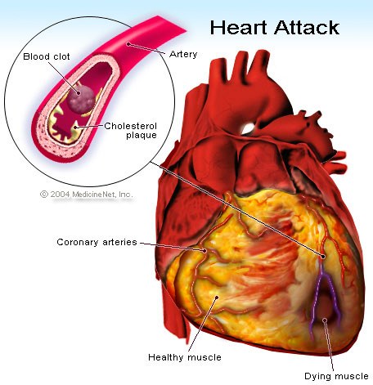


Chest Discomfort May Be a Sign of a Heart Attack
Pressure, heaviness
Squeezing, tightness
Burning
Lasts more than 2 minutes
May come & go
Sometimes Heart Attacks only cause Pain in …
One or both arms. Back. Neck
Shortness of breath. Breaking out in a cold sweat
Nausea, vomiting. Light headedness
Extreme weakness, fatigue
Other Signs of a Heart Attack

Slide 24
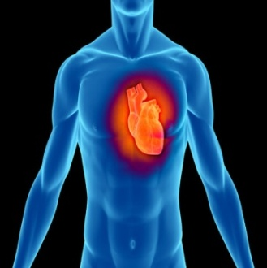

If a guest or employee has symptoms of a heart attack:
- Notify an RN or other healthcare provider
- Assist patient into a wheelchair
- Transport to the Emergency Department
- If there is no ED available, call 911 for emergency care
If a patient has symptoms of a heart attack:
- Notify the patient’s nurse or medical caregiver immediately

Slide 25
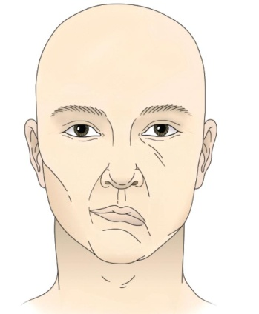
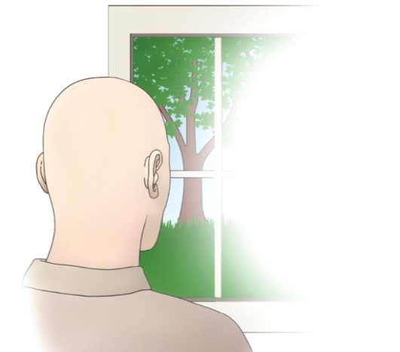
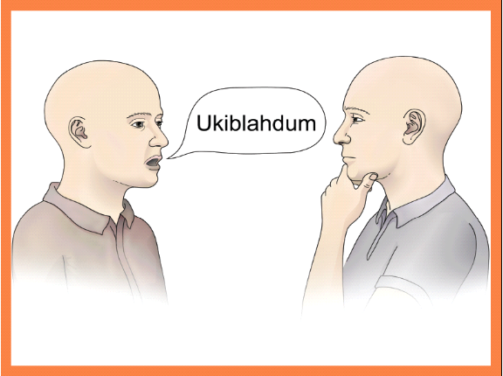

A Stroke Looks Like…
Stroke Signs and Symptoms:
Numbness or weakness of the face, arm or leg…especially on one side!
Trouble seeing in one or both eyes!

Slide 26
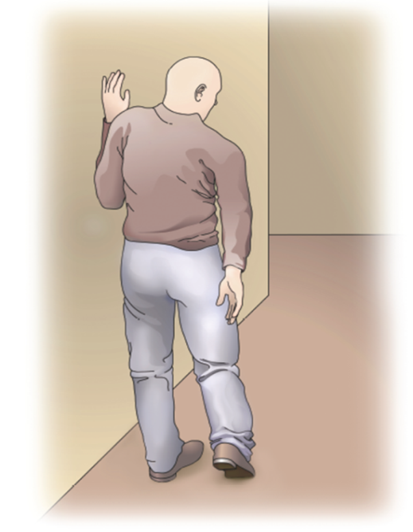
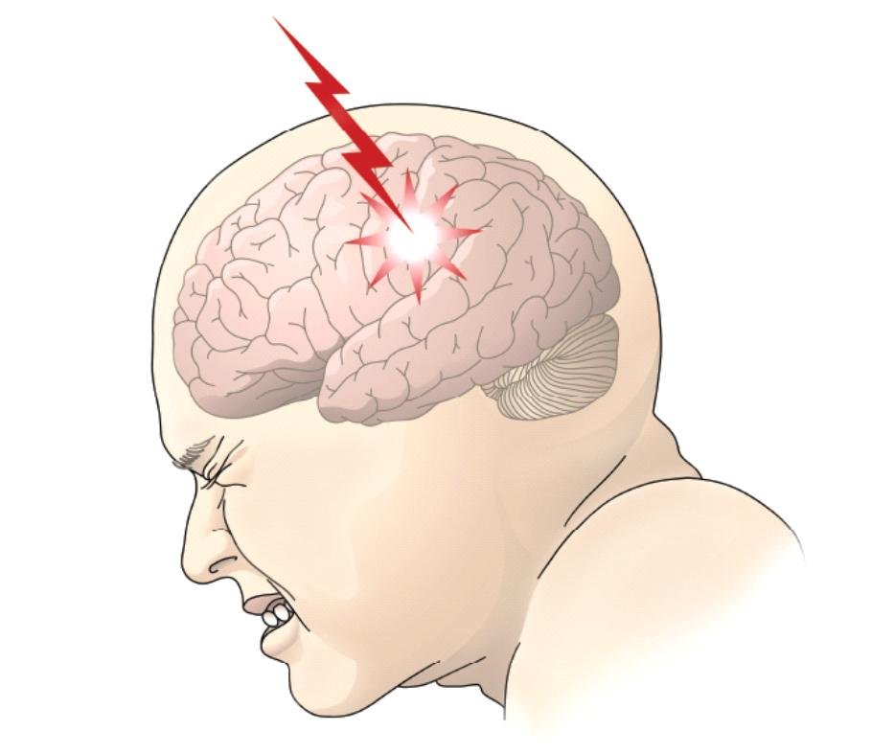
A Stroke Looks Like…
Stroke Signs and Symptoms:
Trouble walking, loss of balance or coordination!
“The Worst Headache of my Life” with no known cause!

Slide 27
What should you do if you think a patient or visitor is having a STROKE?
Notify a Nurse or other Healthcare Provider!
Call if you are not at the hospital!
911
Get Help Fast!

Slide 28
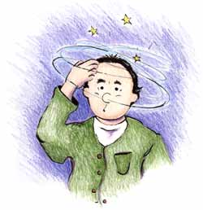

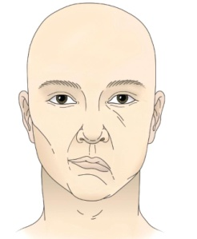


You can make a difference in a stroke patient’s life!
“Be FAST”
REMEMBER…
Balance
Eyes
Double
Blurred
Facial
Droop
Arm
Leg
Weakness
Speech
TIME!
“BE FAST was developed by Intermountain Healthcare, as an adaptation of the FAST model implemented by the American Stroke Association.
Reproduced with permission from Intermountain Healthcare. Copyright 2011, Intermountain Healthcare.”
Notes:
B – behavior change – confused
E – eyes - vision problems
F – facial droop on one side
A – arm, leg weakness; inability to ambulate
S – speech slurred
T – time is of the essence

Slide 29
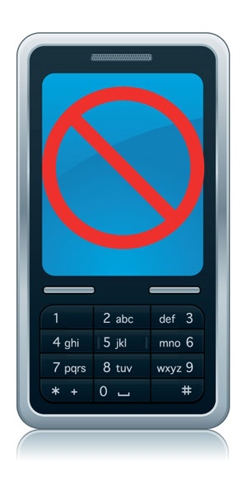
General Guidelines
Phones/Valuables
• Personal phone calls should be limited to emergencies.
• Personal cellular phones are to be turned
off and not used in
clinical settings.
• Storage is limited for personal belongings.
• Valuables cannot be secured.
Avoid social media posts.
Caution topics for public conversations
Printing materials is prohibited
Notes:
Orientation – make sure you get the department phone number and give it and your schedule to your significant others.
HIPAA – don’t even give the impression you are talking about a patient.

Slide 30

General Guidelines
Student Parking
Carpooling is strongly encouraged on each campus.
Moses Cone Hospital –3rd level of the Visitor Garage accessed from Church Street
Wesley Long Hospital – Employee parking lot located off N. Elam and Friendly avenues.
Women’s Hospital –Upper Employee Lot
Annie Penn Hospital Employee parking lot located adjacent to the South Main Street exit of the hospital lot.
Behavioral Health Hospital – Upper middle lot and to the left of the building.
Alamance Regional Medical Center – S Lot across from Medical Mall entrance

Slide 31

THANK YOU
We are confident you will have an exceptional learning experience at Cone Health.
Please sign the
Orientation Acknowledgement Form and give to your Faculty

