Slide 1
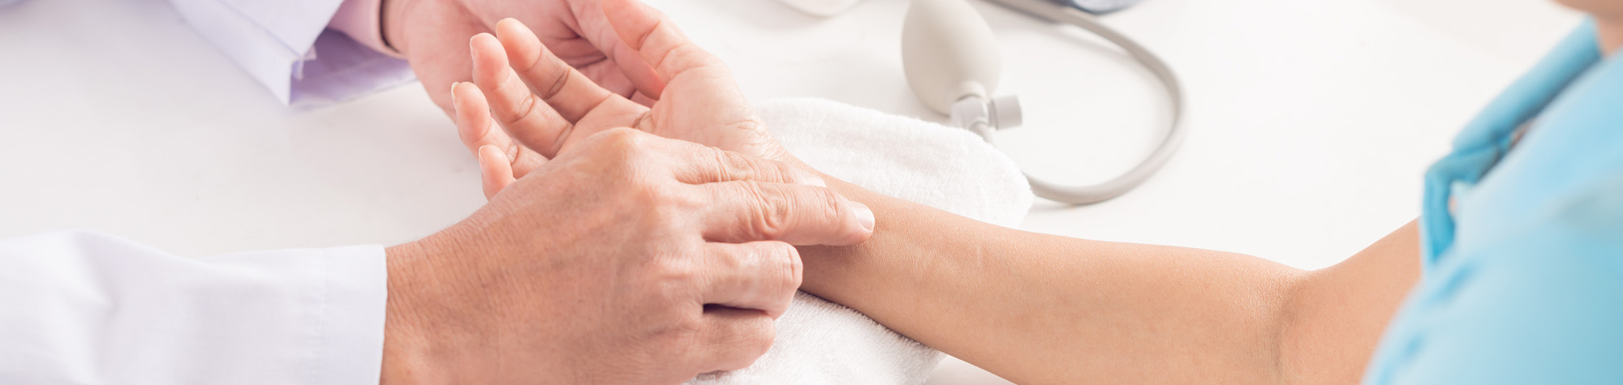
Nursing Student Orientation
Staff Education and Professional Development

Slide 2
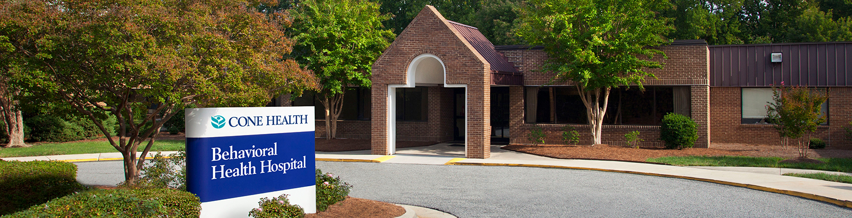
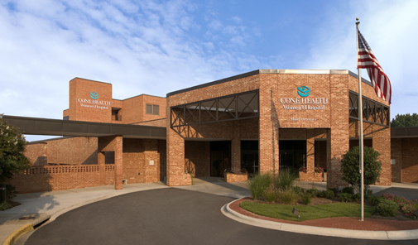
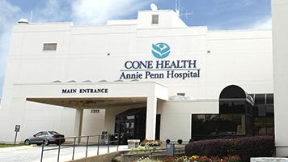
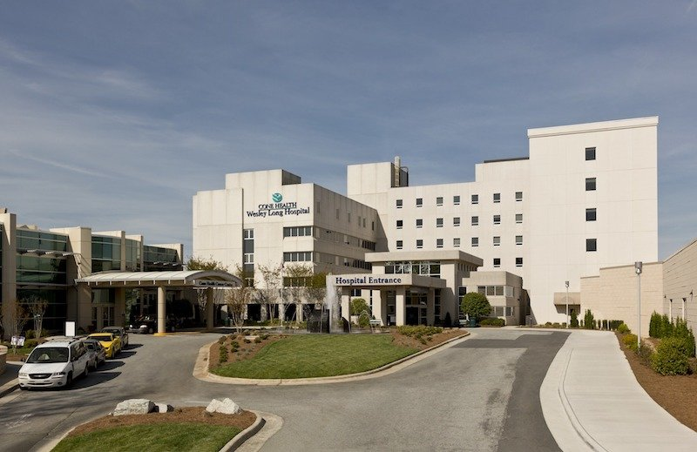
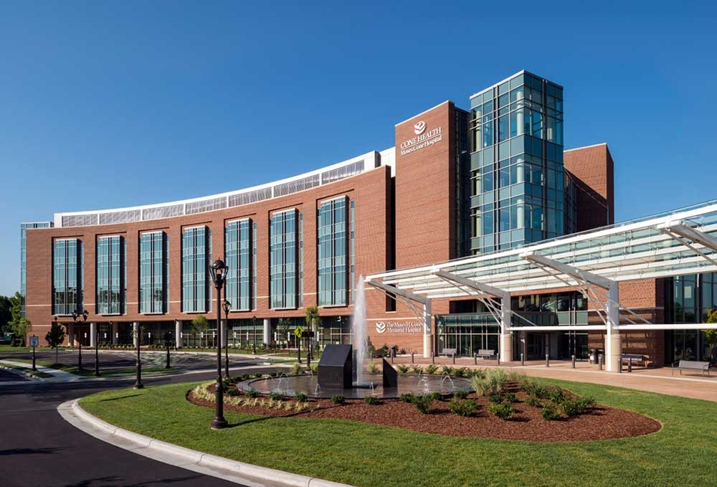
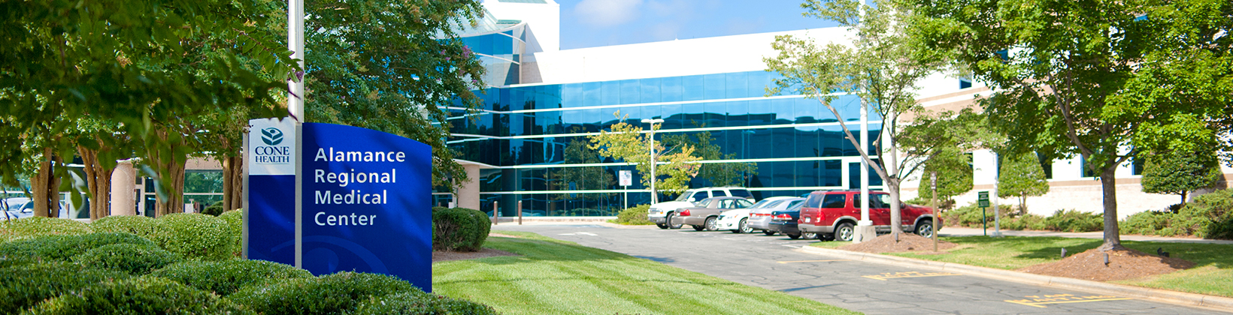
Notes:
The Cone Health system is comprised of over 10,000 employees spanning all the way from Kernersville to Mebane.
Cone Health is the largest employer in Guilford County
A total of 6 hospitals comprise the health system with a total bed count around 1,200 licensed beds
For ambulatory services, there is a total of more than 150 physician practices, 3 MedCenters, and 3 Urgent Care Centers

Slide 3
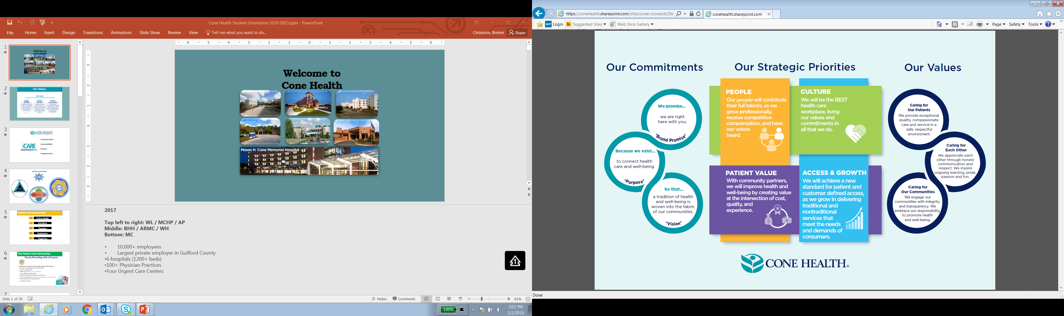
Cone Health Strategic Plan
Notes:
Exceptional people make up the Cone Health Family.
Everyone in Cone Health must be fully committed to our commitments and values.
Our Commitments:
Brand Promise: “We promise, we are right here with you.”
Purpose: “Because we exist to connect health care and well being”
Vision: “So that a tradition of health and well-being is woven into the fabric of our communities”
Our Strategic Priorities
People
Culture
Patient Value
Access and Growth
Our Values
Caring for Our Patients
Caring for Each Other
Caring for Our Communities

Slide 4

iCARE
Notes:
Our method of demonstrating our value of Caring
Communication
Accountability
Respect
Empowerment

Slide 5
AIDET
A
Acknowledge
Acknowledge the patient and visitors by saying “Hello”
I
Introduce
Introduce yourself and role in the care team
D
Duration
T
If there are any delays in treatment – disclose to the patient
E
Explanation
Tell the patient the reason you are doing a particular intervention
Thank you
Thank the patient for allowing you to care for him/her
Notes:
Acknowledgement and Introduction demonstrate courtesy and respect to people
Duration and Explanation help to keep the patient/person informed

Slide 6
Partnering with the Patient for Exceptional Care
Hourly Rounding with a Purpose
Use warm acknowledgement to reduce anxiety
Perform scheduled tasks
Address the 3 Ps (Pain, Potty, Positioning)
Assess additional comfort needs
Conduct an environmental assessment of the room
Prior to leaving the room, ask, “Is there anything else I can do for you?”
Tell each patient when you will be back
Document the round
Notes:
In addition to our internal models of patient care to guide our practice, we have several accrediting bodies we are accountable to – TJC (The Joint Commission), CMS (Centers for Medicare and Medicaid) American Hospital Association …
TJC gives NPSGs:
1.ID patients correctly – Red Rule
2. Improve Staff Communication – Hand-off/ Hall pass
3. Use medicines safely – 5 rights / pharmacy unit-dose dispensing / medication bar-code scanner
4. Prevent Infection – Admission screening / isolation / post-op measures
5. ID patient safety risks – yellow arm band
6. Prevent mistakes in surgery – Red Rules
7. Use alarms safely

Slide 7
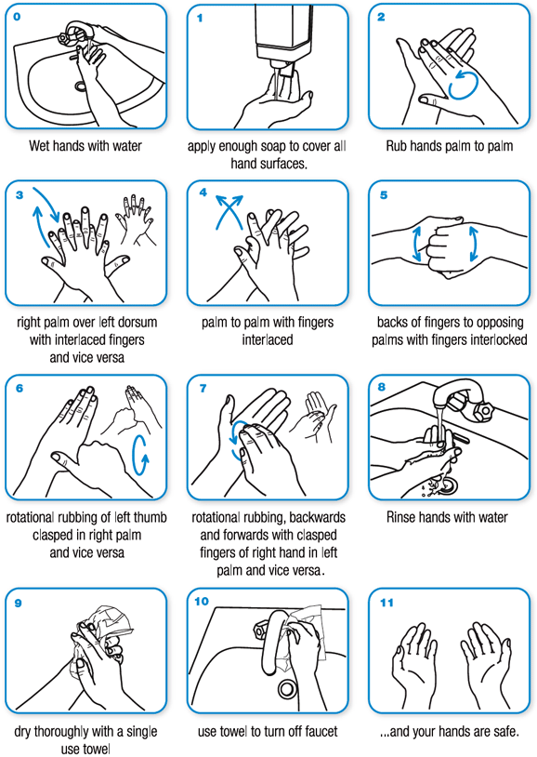
Handwashing
#1 way to prevent HAIs
Every time you cross the threshold!
Per the World Health Organization (WHO)
  Clean your hands regularly.
  Wash your hands with soap and water, and dry them thoroughly.
  Use alcohol-based handrub if you don’t have immediate access to soap and water.
https://www.who.int/gpsc/clean_hands_protection/en/

Slide 8
Falls Prevention
Interventions are based off of falls risk assessment
Example Interventions
  Patient Safety Plan
  Hourly Rounding
  Universal Precautions
  “Call, Don’t Fall” sign in room
  Yellow Fall Risk Armband
  Fall Risk Signage for staff
  Bed Alarm/Chair Alarm
  Patient Door Open
  Yellow Socks
Johns Hopkins Fall Risk Assessment Tool
Low Risk: 0-5 Points
Moderate Risk: 6-13 Points
High Risk: >13 Points
Notes:
Fall Risk Hazards
a. Clutter/obstacles
b. Lack of adequate lighting
c. Inoperable locks on bed/stretcher/wheelchair; missing parts (rubber feet on the bedside commodes)
d. Slippery floor
e. Electrical cords on floor

Slide 9
Cone Health and HIPAA/Privacy
No printing of the medical record
All PHI must be discarded in the approved confidential waste bins prior to leaving a nursing unit
If any breach in patient privacy occurs, immediately notify charge nurse – Safety Zone Portal Incident Report will need to be filed
Privacy Flags
  Patient is not part of the “public census”
  If someone were to call about a patient with a privacy flag in their chart: deny that the patient is admitted to the facility.

Slide 10

IT Reminders
Assist Desk (IT Service Desk): 2-7242
Log off of computer/CHL when completed with work
Never share IDs or passwords with anyone
All CHL documentation and access is regularly audited – View patient information only if you have a direct patient care relationship
Cone Health employees will need a second account generated for student or faculty use

Slide 11

Safety Zone Portal
Any event that is a deviation from Cone Health policy or procedure or expected care should be reported
SZP allow for appropriate follow up to concern
Documentation Reminders
  Document objectively in the EMR
    Do NOT say SZP or incident report was filed
  Document incident report in the SZP
    Focus on objective details
    Leave opinions and subjectivity out
Notes:
Risk Management
Any incident that may have adverse consequences for patients, visitors, faculty/students should be reported immediately to leadership on the department where incident occurred.
SZP is entered into the system
Sentinel Events – Death or permanent loss of function
Immediately contact department director and risk management
Root Cause Analysis
Literature Review
Action Plan
Goal
risk identification
risk evaluation
claims management
minimize loss
improve quality of medical services and safety
Appropriate follow up by department director and risk management

Slide 12

Ethics
Ethics Consult and Interpreter Requests are obtained through the office of Pastoral Care
Cone Health offers ethics consults for patients, families, medical staff, and ancillary staff involved in patient care

Slide 13
Plain Language Emergency Codes
Goal: transparency
In accordance with the American Hospitals Association
  Goal of Standardization → minimization of confusion or errors
Medical Emergency (Code Blue) will typically be sent by pager
Bomb Threats will be transmitted via radio to security officers
Examples:
  Fire Alarm: “Attention, Facility Alert, Fire Alarm, 5 North, Reference Pull Station”
  Missing Child/Infant: “Attention, Security Alert, Missing Pediatric Patient, Male 2 year old, last seen room 618”
  Weather: “Attention, Facility Alert, Tornado Warning, move away from all windows to interior portions of the building”
  Mass Casualty: “Attention, Facility Alert, External Mass Casualty Incident, Emergency Department”

Slide 14
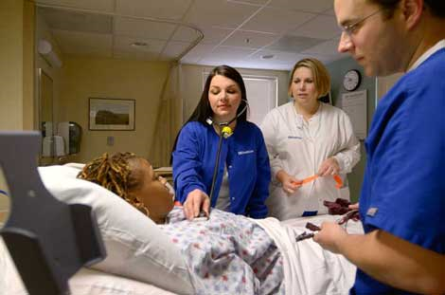
Rapid Response Team and Condition Help
Rapid Response provides early and rapid intervention for patients outside the ICUs whose condition is deteriorating
Condition Help
  Safety Net program for patient and families
  Ability for patients and families to activate a call for help from any hospital phone
Notes:
A rapid response call will dispatch the critical care team to the patient’s bedside to assist with stabilizing and transferring to a higher level of care as needed.
Purpose is to provide early and rapid interventions for more positive outcomes → identify early warning signs

Slide 15

Code STEMI
If any patient experiences the following signs/symptoms of a myocardial infarction/heart attack, call a Rapid Response!
Chest Discomfort
Chest Pressure
Chest Heaviness
Tightness in the Chest
Burning
Squeezing in the Chest
Pain the arm(s)
Back or neck pain
Shortness of Breath
Cold Sweat
Nausea/Vomiting
Light Headedness
Weakness
Fatigue

Slide 16
Code Stroke
B
Balance
Loss of Balance
E
Eyes
Blurred Vision
F
Face
One side of the face is drooping
A
Arm
S
Weakness in an arm or leg (can be one or can be both)
Speech
T
Difficulty speaking (Aphasia)
Time
Headache
Dizziness
Immediate action MUST be taken! Do not delay
Purpose of Code Stroke “provide rapid, consistent assessment and initiation of time-appropriate treatment to adults (18 years and older) who present with sudden onset of stroke symptoms within 0-24 hours of last known well (LKW) time.”
Cone Health Policy
PR-NSG-2001-12

Slide 17
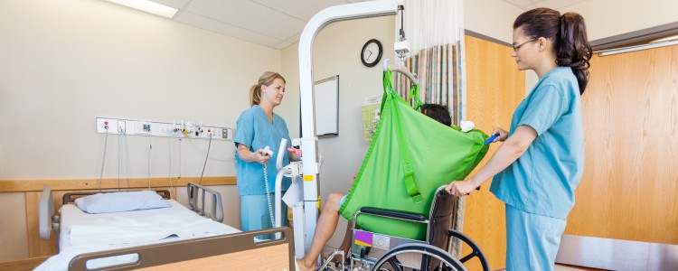
Safe Patient Handling
All patient transfer/lifting will be done safely and appropriately to protect the employee and patient from injury
Consult with nurse for guidance

Slide 18
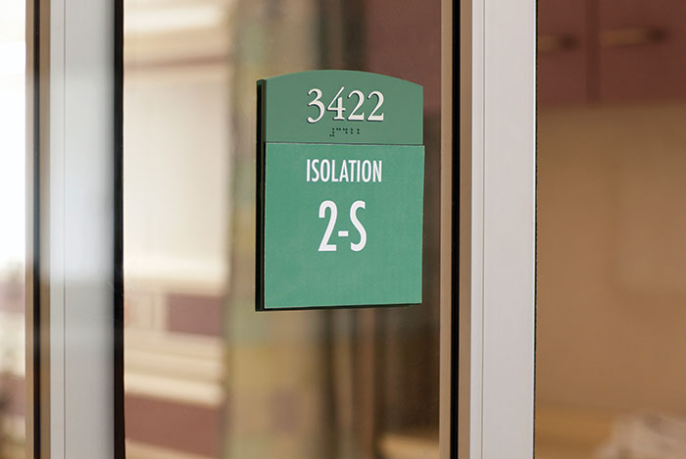
Isolation
All isolated patients will require to have appropriate signage on doors
No student should be assigned to any patient that require special mask (example: N95 for tuberculosis)
  Students are not fit-tested

Slide 19

I-SBAR-Q
Framework for team members to effectively communicate information to one another
I – Introduce
S – Situation
B – Background
A – Assessment
R – Recommendation
Q – Questions
Notes:
Know what needs to be communicated!
When activating a Rapid Response or notifying a physician, have the following information available:
Code Status
Current Medications
Allergies
Recent VS and trend
New Labs and trend
Pertinent PMSHx

Slide 20

General Guidelines for Students
Cell Phones
Cell phones should be turned off and not in use in any clinical setting
Personal phone calls should be limited to emergencies only

Slide 21

General Guidelines for Students
Personal Belongings and Valuables
Storage is limited
Valuables cannot be secure
The less you bring to clinical site the better!

Slide 22

General Guidelines for Students
Patient Privacy
Do not post on social media regarding any experiences at Cone Health.
No discussions about patients or clinical experiences should take place in any public area at any time
No printing of any materials that contain PHI

Slide 23
Parking Assignments
Campus/Site | Instructor/Student Parking Location
Moses H. Cone Memorial Hospital | Visitor Garage (accessed from N. Church St) Level 3
Wesley Long Hospital | Employee Parking Lot (N. Elam Ave & Friendly Ave)
Women’s Hospital | Upper Employee Lot
Annie Penn Hospital | Employee Parking Lot (next to S. Main Street exit)
Behavioral Health Hospital | Upper Middle Lot Left Parking Lot
Alamance Regional Medical Center | S Lot

